Slide 1

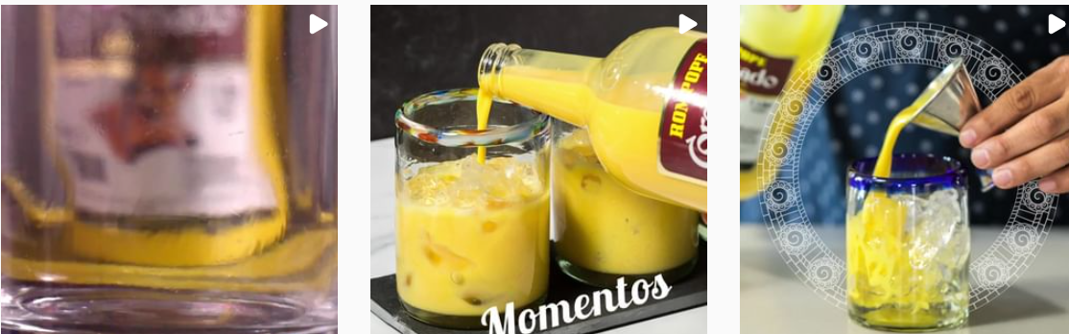
ROMPOPECORONADOUSA INSTAGRAM POSTING
JULY 2020

Slide 2
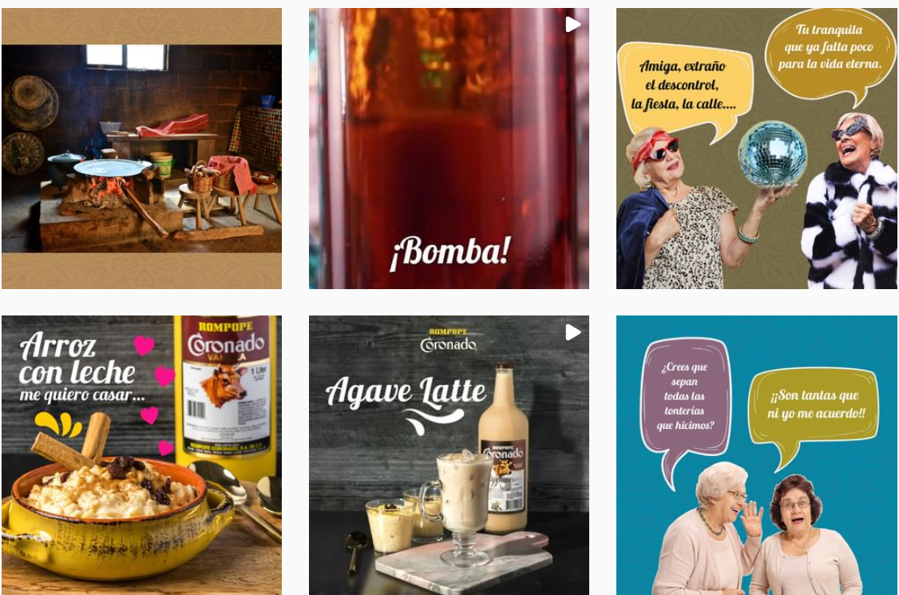
ROMPOPECORONADOUSA INSTAGRAM POSTING
AUGUST 2020

Slide 3

ROMPOPECORONADOUSA INSTAGRAM POSTING
AUGUST 2020

Slide 4
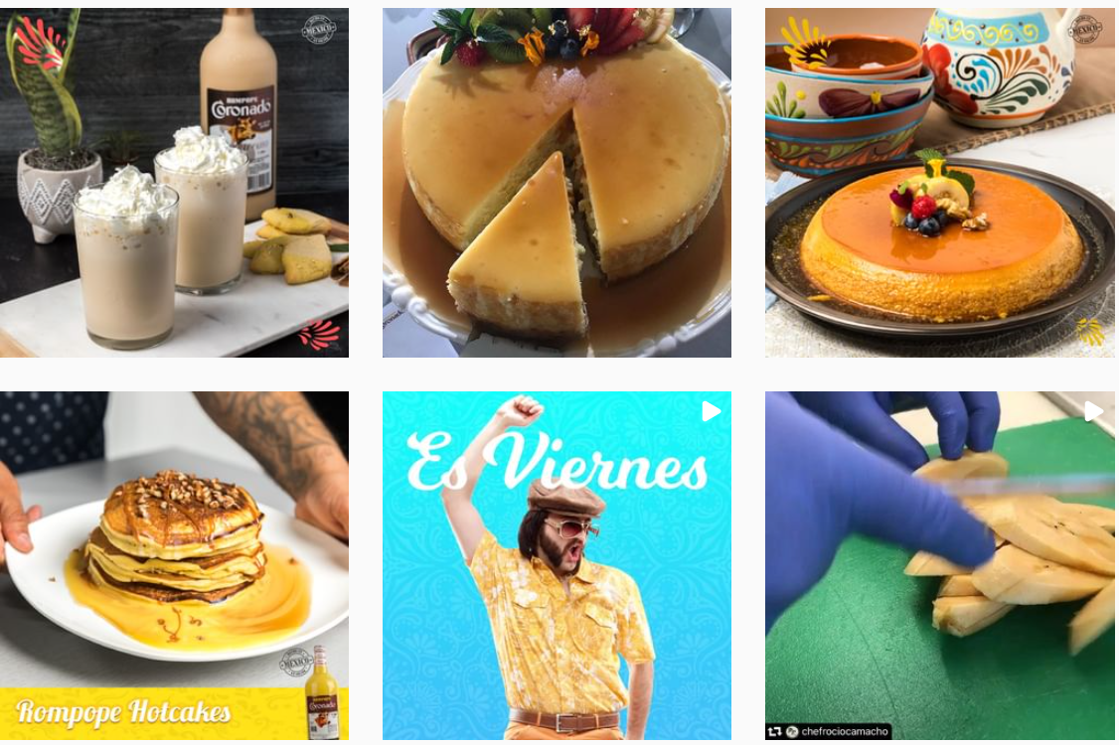
ROMPOPECORONADOUSA INSTAGRAM POSTING
AUGUST 2020

Slide 5
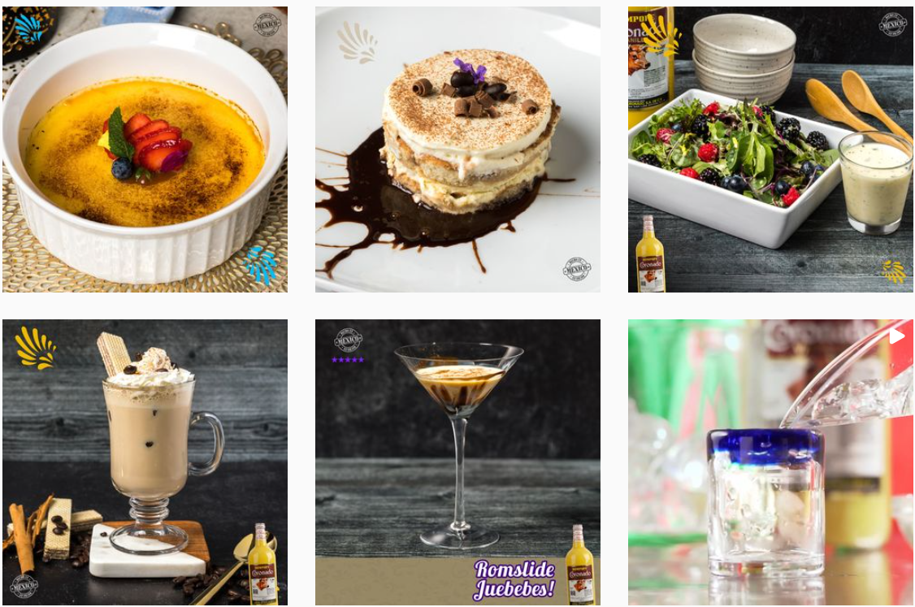
ROMPOPECORONADOUSA INSTAGRAM POSTING
SEPTEMBER 2020

Slide 6
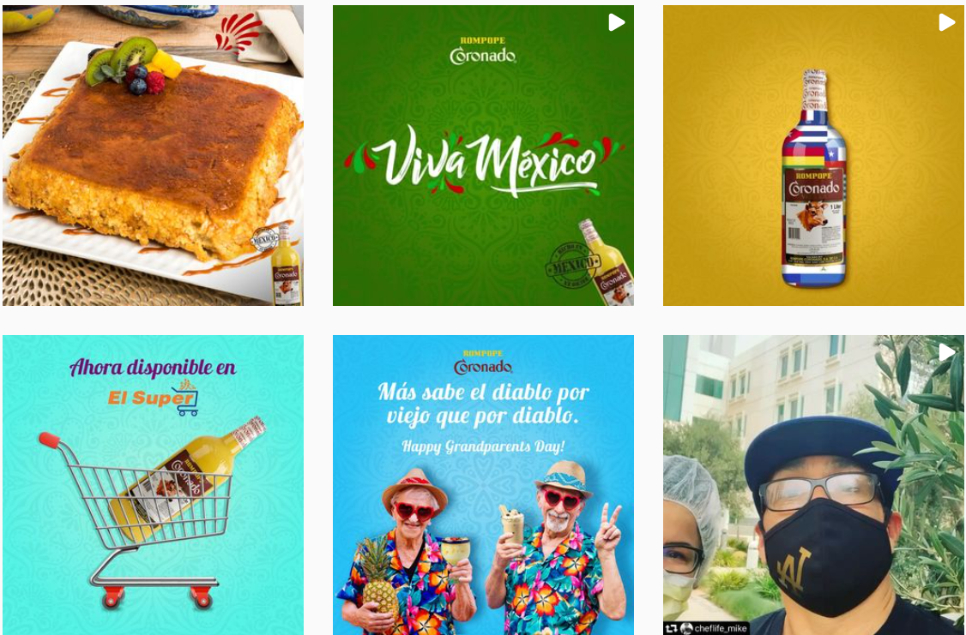
ROMPOPECORONADOUSA INSTAGRAM POSTING
SEPTEMBER 2020

Slide 7
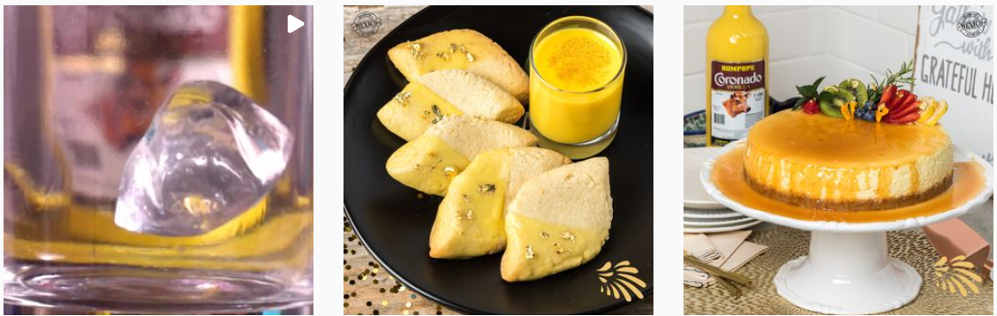
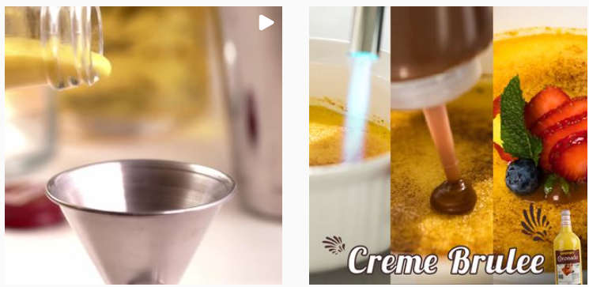
ROMPOPECORONADOUSA INSTAGRAM POSTING
SEPTEMBER 2020

Slide 8



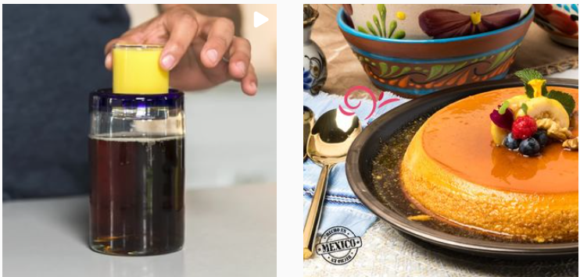
ROMPOPECORONADOUSA INSTAGRAM POSTING
OCTOBER 2020

Slide 9
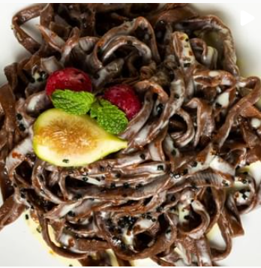
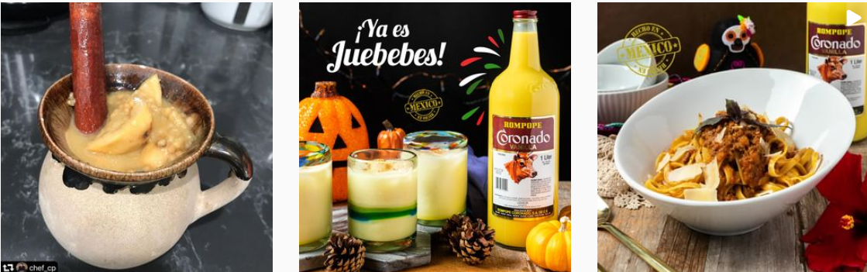
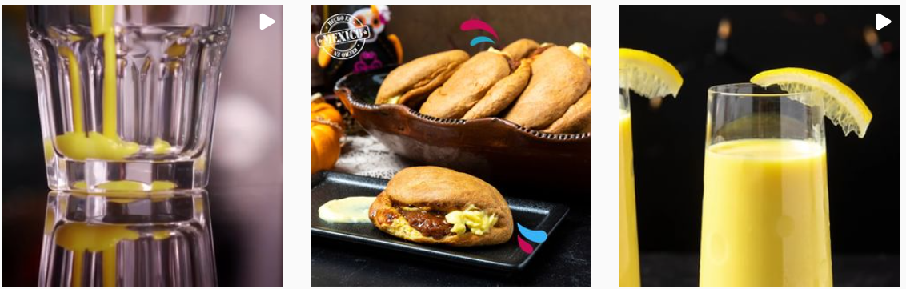
ROMPOPECORONADOUSA INSTAGRAM POSTING
OCTOBER 2020

Slide 10
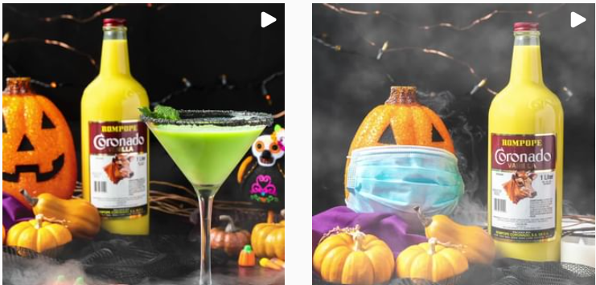
ROMPOPECORONADOUSA INSTAGRAM POSTING
OCTOBER 2020

Slide 11
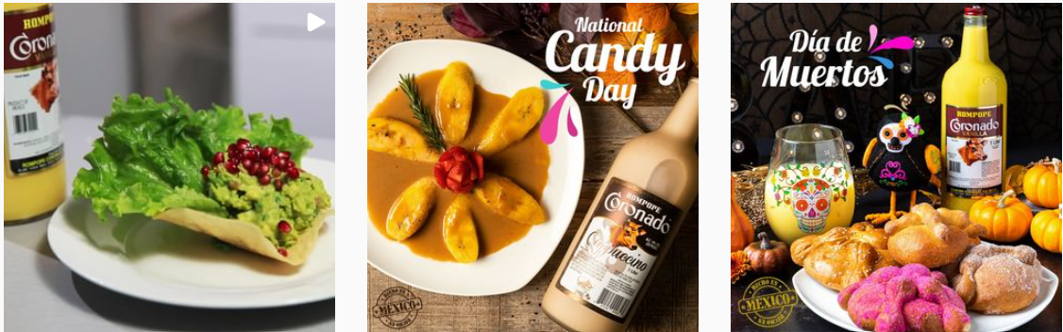

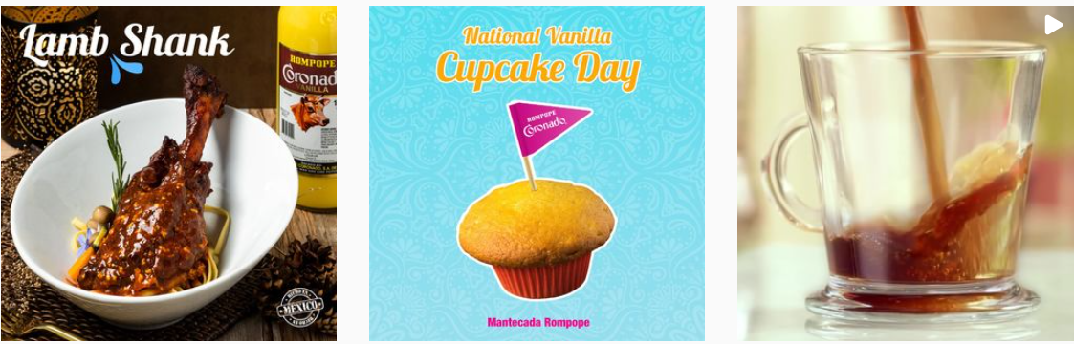
ROMPOPECORONADOUSA INSTAGRAM POSTING
NOVEMBER 2020

Slide 12
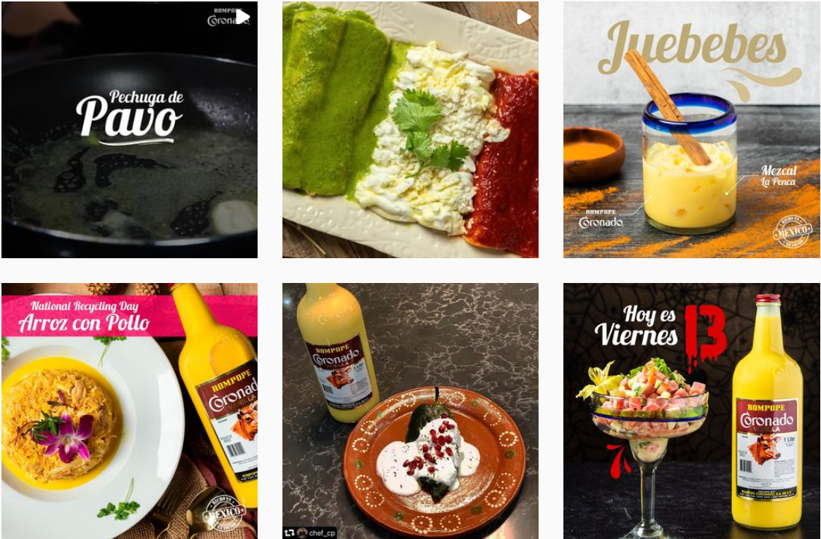
ROMPOPECORONADOUSA INSTAGRAM POSTING
NOVEMBER 2020

Slide 13

ROMPOPECORONADOUSA INSTAGRAM POSTING
NOVEMBER 2020

Slide 14

ROMPOPECORONADOUSA INSTAGRAM POSTING
DECEMBER 2020

Slide 15
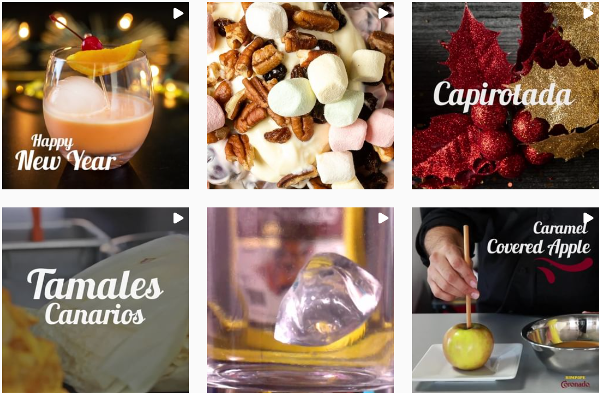
ROMPOPECORONADOUSA INSTAGRAM POSTING
DECEMBER 2020

Slide 16
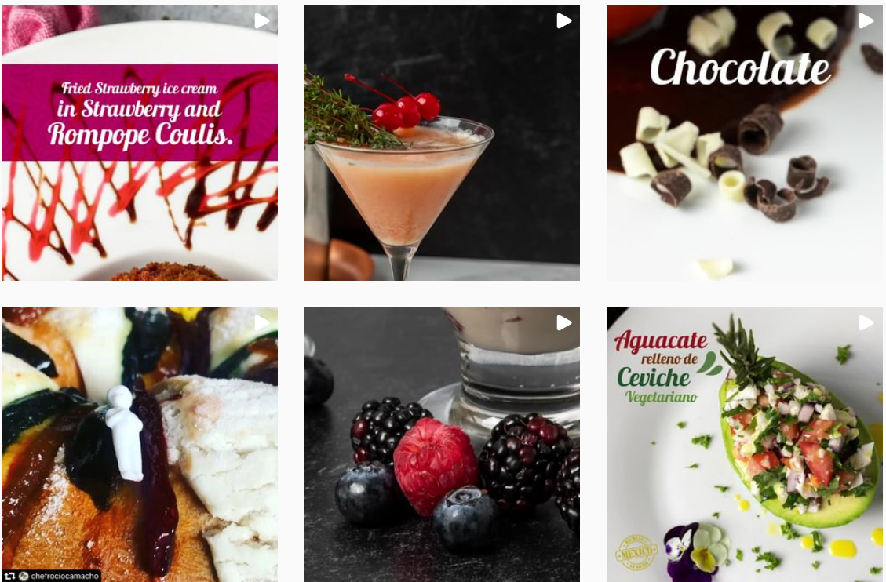
ROMPOPECORONADOUSA INSTAGRAM POSTING
JANUARY 2021

Slide 17
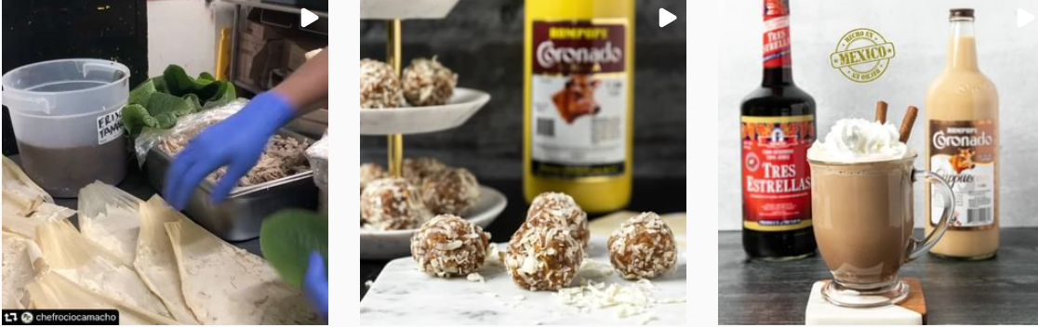
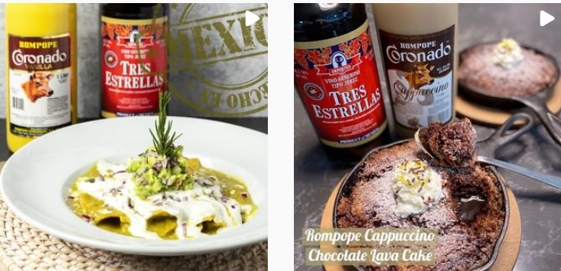
ROMPOPECORONADOUSA INSTAGRAM POSTING
JANUARY 2021

Slide 18
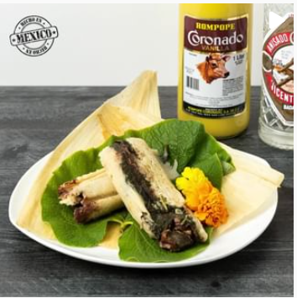
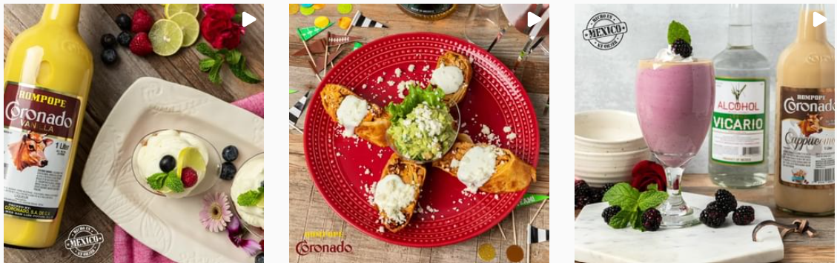
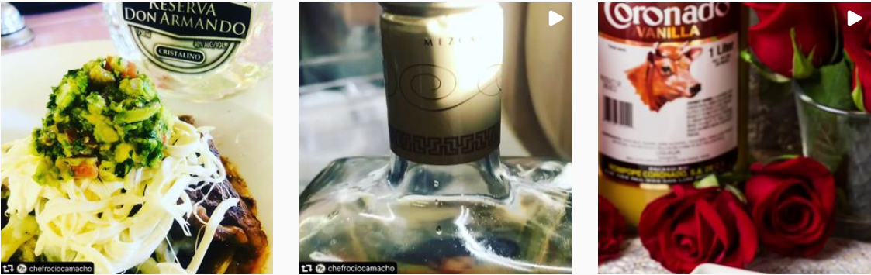
ROMPOPECORONADOUSA INSTAGRAM POSTING
FEBRUARY 2021

Slide 19
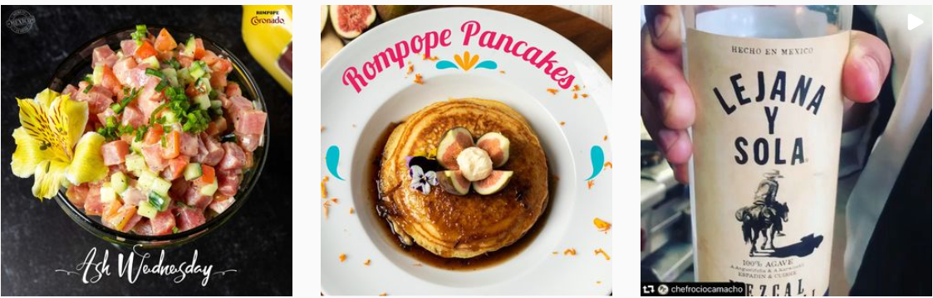

ROMPOPECORONADOUSA INSTAGRAM POSTING
FEBRUARY 2021

Slide 20
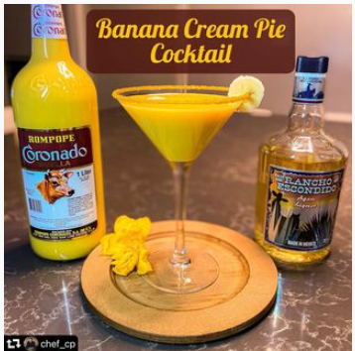


ROMPOPECORONADOUSA INSTAGRAM POSTING
MARCH 2021

Slide 21
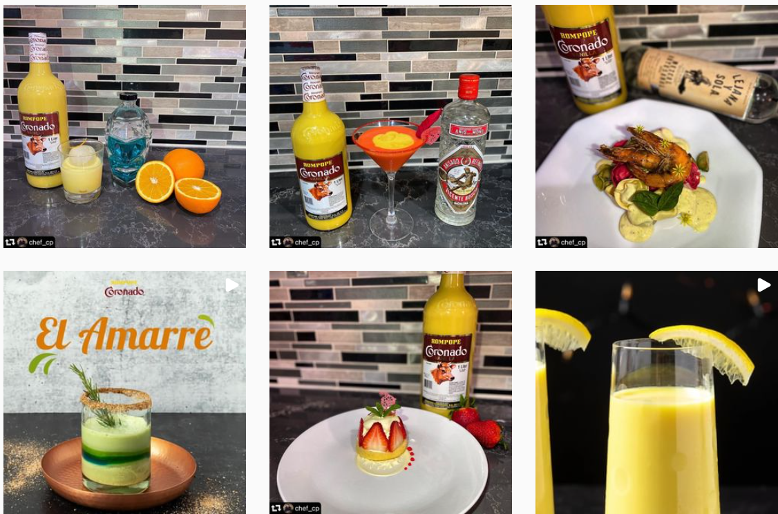
ROMPOPECORONADOUSA INSTAGRAM POSTING
MARCH 2021

Slide 22

ROMPOPECORONADOUSA INSTAGRAM POSTING
APRIL 2021

Slide 23


ROMPOPECORONADOUSA INSTAGRAM POSTING
APRIL 2021

Slide 24
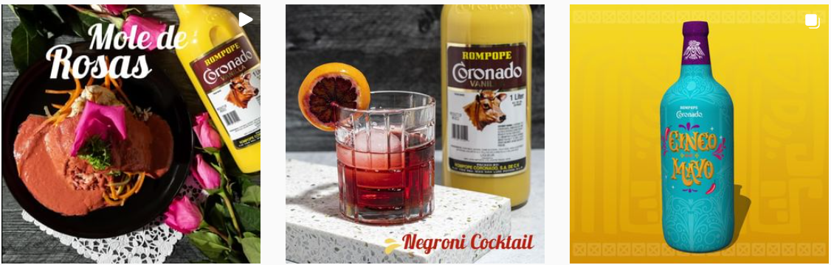
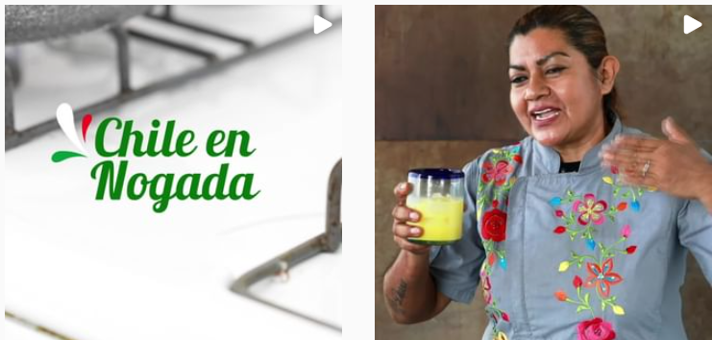
ROMPOPECORONADOUSA INSTAGRAM POSTING
MAY 2021

