Slide 1


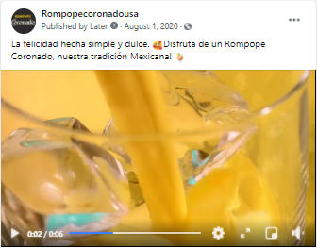



ROMPOPECORONADOUSA FACEBOOK SOCIAL POSTING
AUGUST 2020

Slide 2

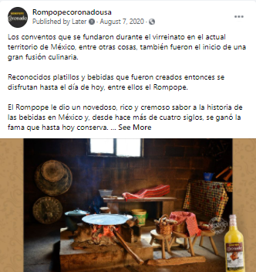
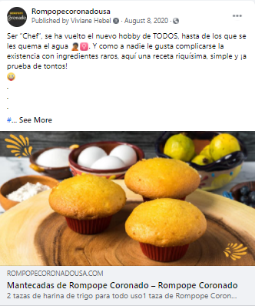

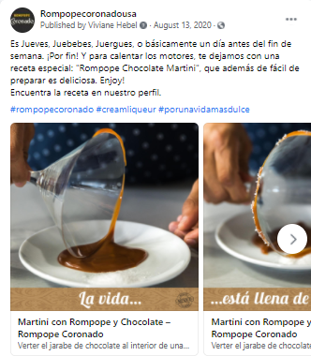



ROMPOPECORONADOUSA FACEBOOK SOCIAL POSTING
AUGUST 2020

Slide 3

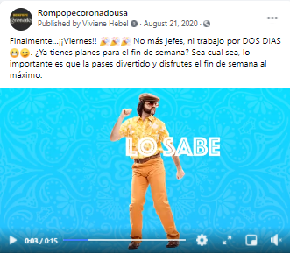


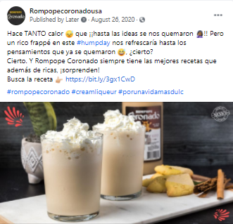
ROMPOPECORONADOUSA FACEBOOK SOCIAL POSTING
AUGUST 2020

Slide 4


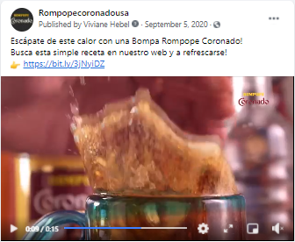
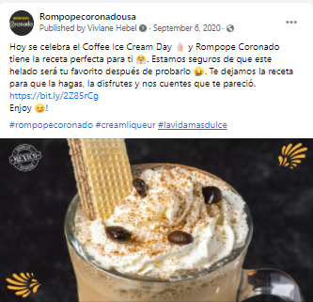


ROMPOPECORONADOUSA FACEBOOK SOCIAL POSTING
SEPTEMBER 2020

Slide 5






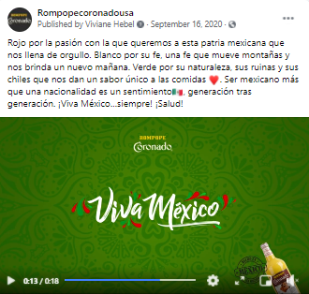
ROMPOPECORONADOUSA FACEBOOK SOCIAL POSTING
SEPTEMBER 2020

Slide 6

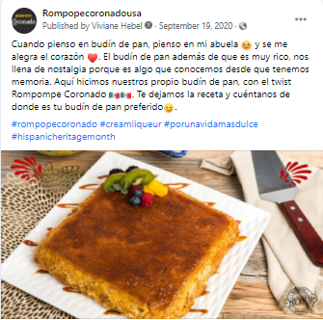





ROMPOPECORONADOUSA FACEBOOK SOCIAL POSTING
SEPTEMBER 2020

Slide 7



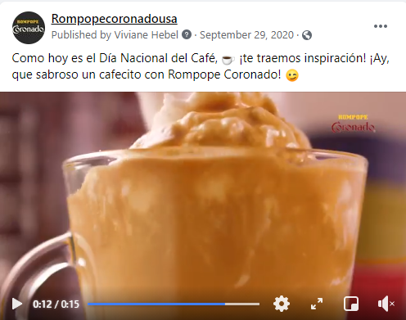
ROMPOPECORONADOUSA FACEBOOK SOCIAL POSTING
SEPTEMBER 2020

Slide 8





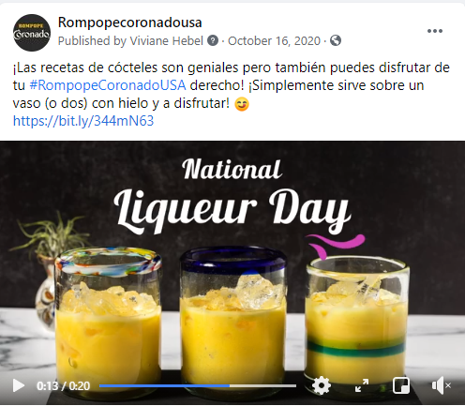
ROMPOPECORONADOUSA FACEBOOK SOCIAL POSTING
OCTOBER 2020

Slide 9
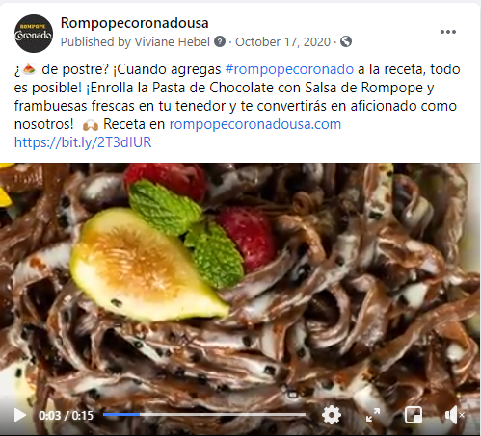
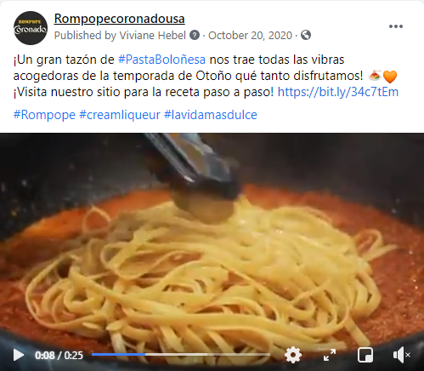


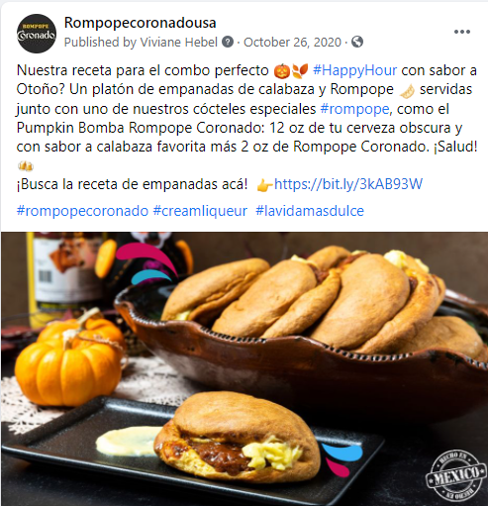
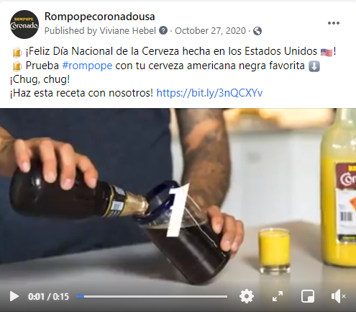
ROMPOPECORONADOUSA FACEBOOK SOCIAL POSTING
OCTOBER 2020

Slide 10


ROMPOPECORONADOUSA FACEBOOK SOCIAL POSTING
OCTOBER 2020

Slide 11
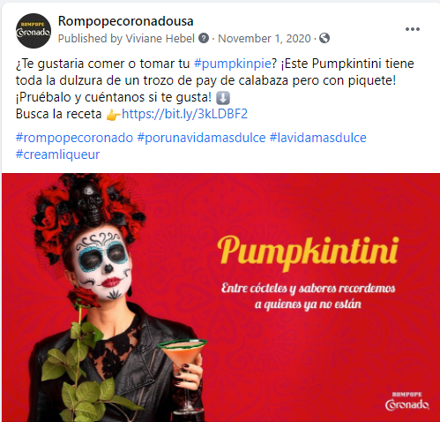
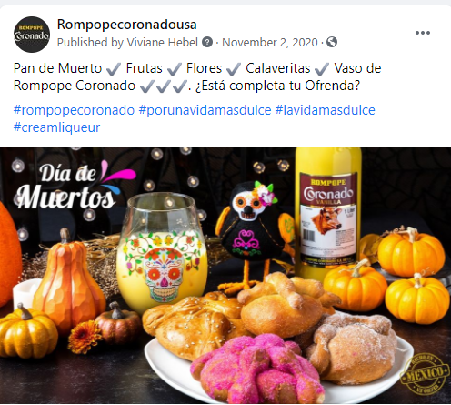

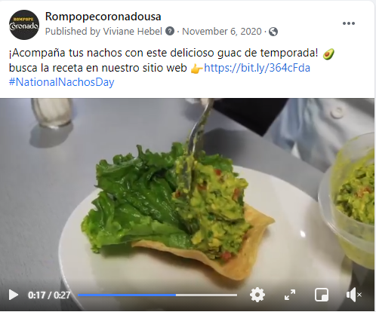
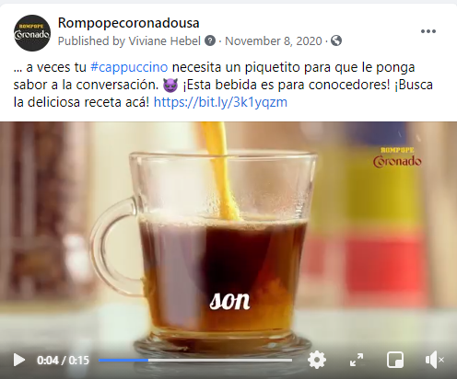

ROMPOPECORONADOUSA FACEBOOK SOCIAL POSTING
NOVEMBER 2020

Slide 12




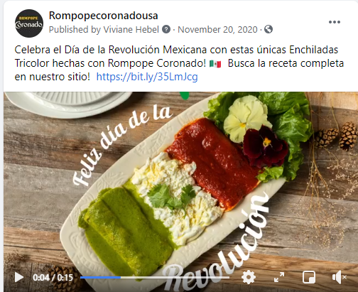

ROMPOPECORONADOUSA FACEBOOK SOCIAL POSTING
NOVEMBER 2020

Slide 13

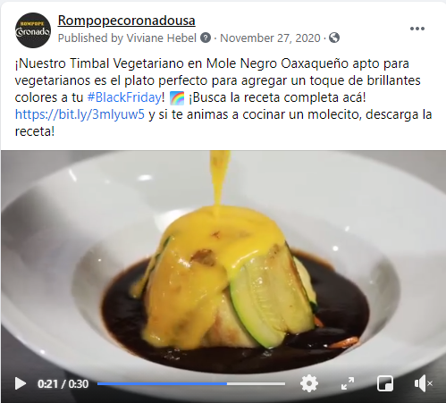

ROMPOPECORONADOUSA FACEBOOK SOCIAL POSTING
NOVEMBER 2020

Slide 14



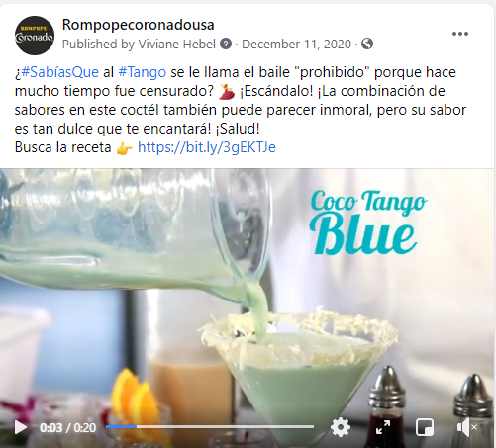
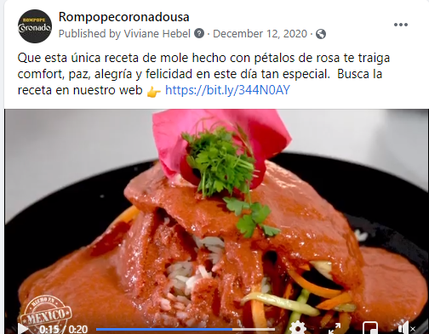
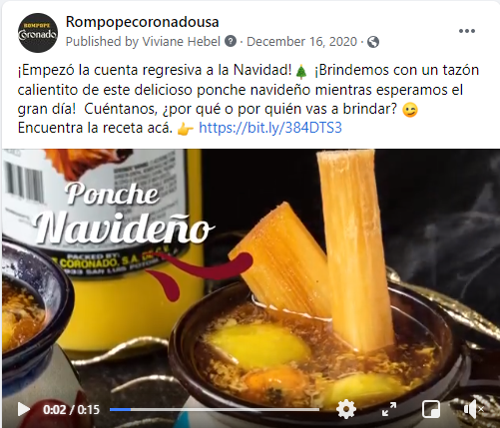
ROMPOPECORONADOUSA FACEBOOK SOCIAL POSTING
DECEMBER 2020

Slide 15
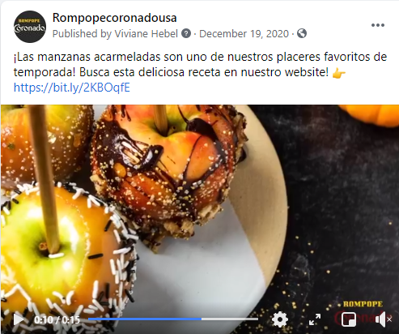

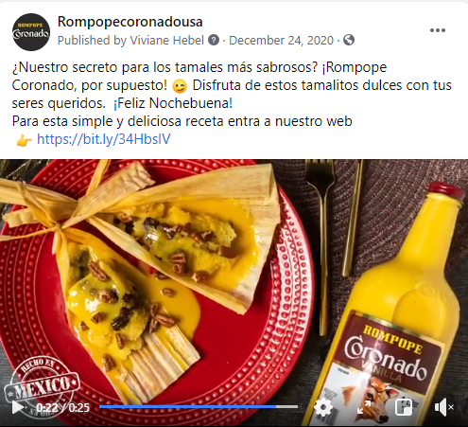


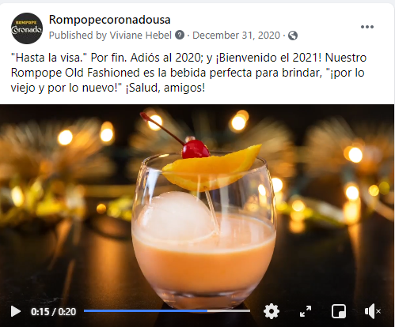
ROMPOPECORONADOUSA FACEBOOK SOCIAL POSTING
DECEMBER 2020

Slide 16
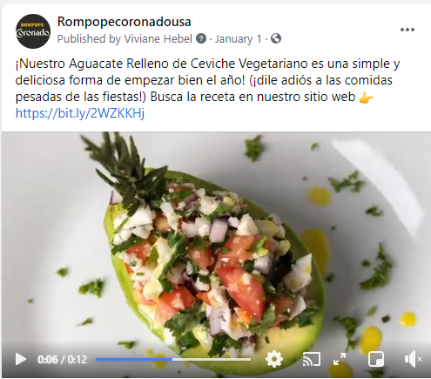

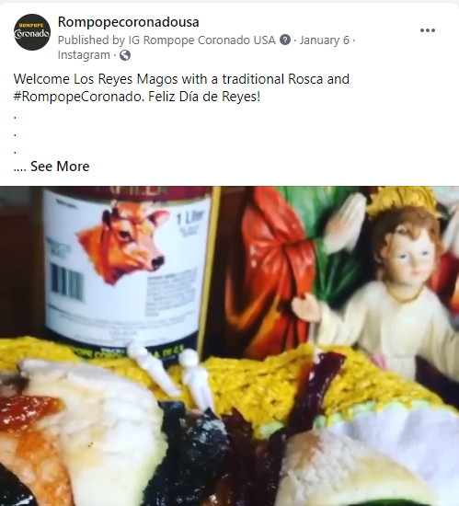

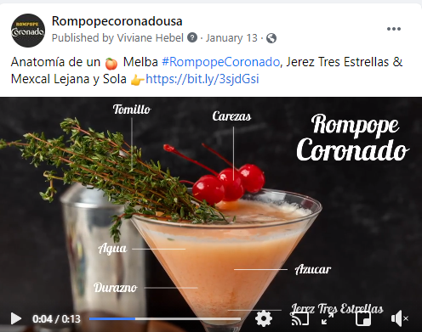

ROMPOPECORONADOUSA FACEBOOK SOCIAL POSTING
JANUARY 2021

Slide 17
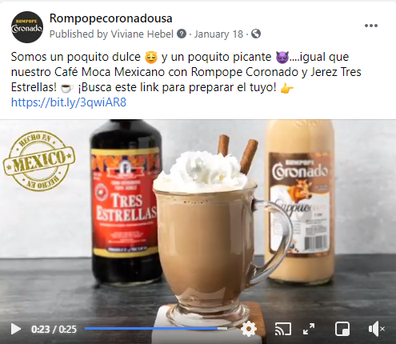

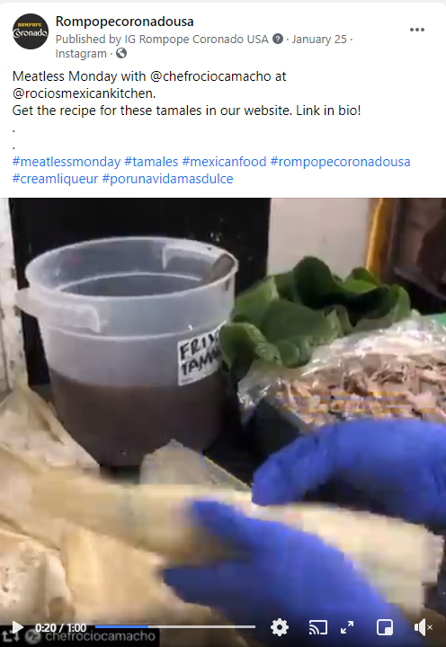


ROMPOPECORONADOUSA FACEBOOK SOCIAL POSTING
JANUARY 2021

Slide 18
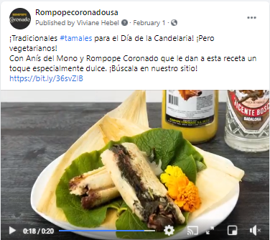
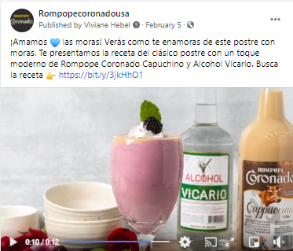
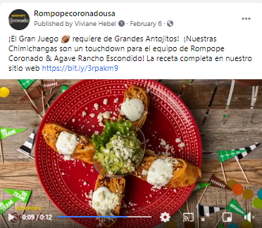




ROMPOPECORONADOUSA FACEBOOK SOCIAL POSTING
FEBRUARY 2021

Slide 19


ROMPOPECORONADOUSA FACEBOOK SOCIAL POSTING
FEBRUARY 2021

Slide 20

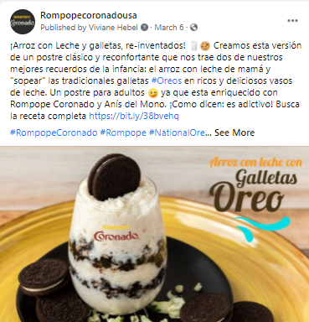

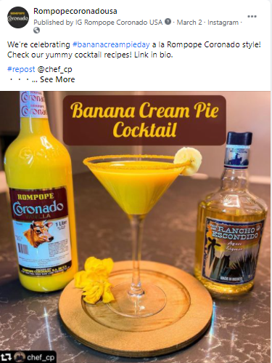


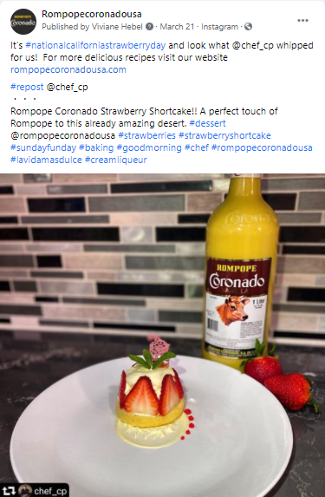
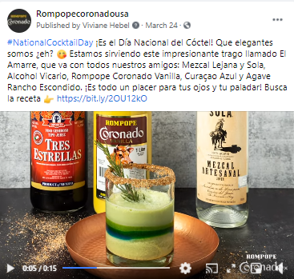
ROMPOPECORONADOUSA FACEBOOK SOCIAL POSTING
MARCH 2021

Slide 21
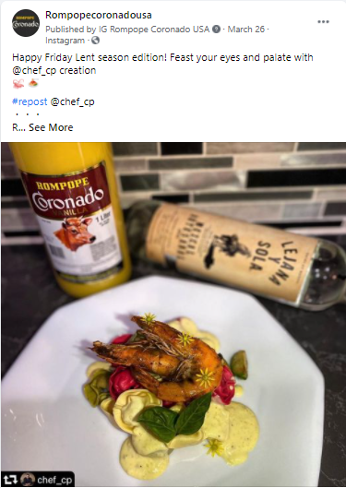
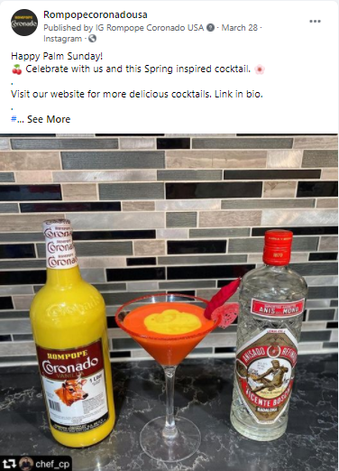
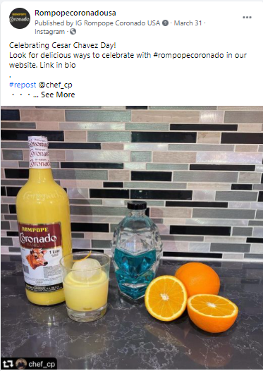
ROMPOPECORONADOUSA FACEBOOK SOCIAL POSTING
MARCH 2021

Slide 22
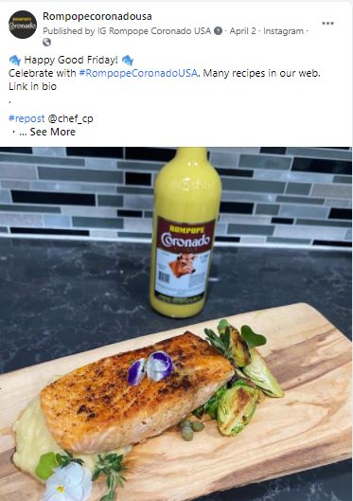







ROMPOPECORONADOUSA FACEBOOK SOCIAL POSTING
APRIL 2021

Slide 23

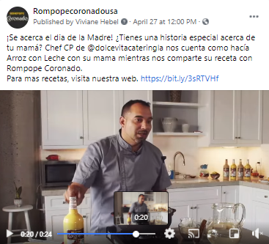
ROMPOPECORONADOUSA FACEBOOK SOCIAL POSTING
APRIL 2021

Slide 24
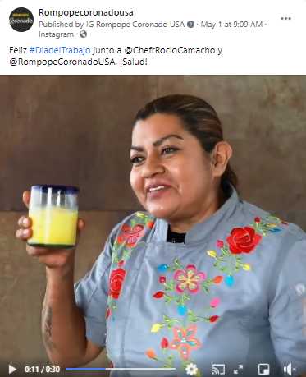
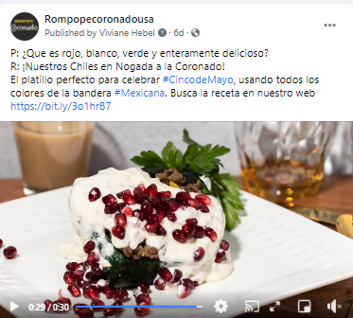



ROMPOPECORONADOUSA FACEBOOK SOCIAL POSTING
MAY 2021

